Slide 1
Biodiversity for the national parks
Saw yu lin
Codecademy-introduction to data analysis

Slide 2
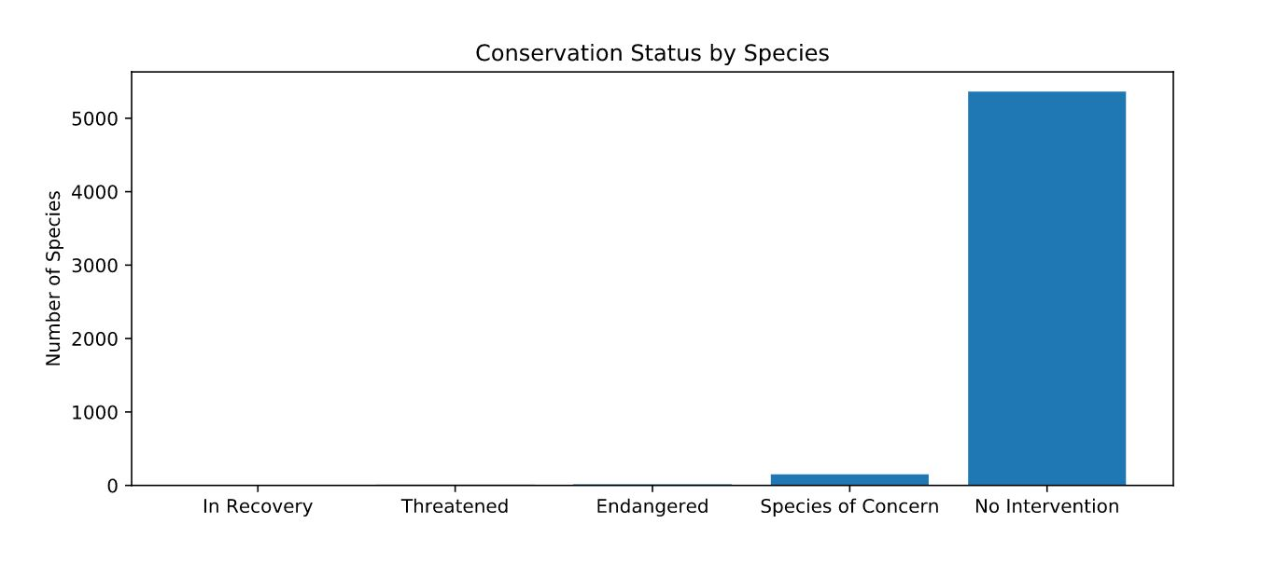
Data in Species Data frame and calculations
Species_info file includes data about different species in National Parks. Data showing Category, Scientific_name, Common_name and Conservation_status for each specie.
In Species data frame, there are total 5541 species count in Species data frame.
Species type included in the data frame are; Mammal, Bird, Reptile, Amphibian, Fish, Vascular Plant.
Following table shows how many species are endangered, how many is in recovery stage, species of concern and species with threatened status, etc. There are 5363 species count has no intervention. It is quite concerning that how many more species are endangered or threatened without us even noticing.
Conservation_status | Count
Endangered | 15
In Recovery | 4
Species of concern | 151
Threatened | 10
No intervention | 5363

Slide 3
Investigating Endangered Species
Following table shows which species categories are actually protected (percentage as well) or not protected.
To get this data, Pivot_table was used and the following calculation was made;
category_pivot = category_counts.pivot(columns=‘is_protected’, index = ‘category’, values=‘scientific_name’).reset_index()
To get percent_protected, the following calculation was made;
category_pivot[‘percent_protected’] = category_pivot.protected(category_pivot.protected + category_pivot.not_protected)
Looking at the protected percentage all of which are not even 1 percent, it is indicating that there is enormous amount of work to be done to protect more species.
Category | Not_protected | Protected | Percent_protected
Amphibian | 72 | 7 | 0.088608
Bird | 413 | 75 | 0.155689
Fish | 115 | 11 | 0.087302
Mammal | 146 | 30 | 0.170455
Nonvascular Plant | 328 | 5 | 0.015015
Reptile | 73 | 5 | 0.064103
Vascular Plant | 4216 | 46 | 0.010793

Slide 4
Investigating Endangered Species-Chi-squared Test
Chi-squared test was used to determine if the differences in the protected percentages of birds, mammals and reptiles is a result of chance or not.
With Chi-squared test, if p-value is equal or more than 0.5, then it is by chance and if it is less than 0.5, then it is a significant difference.
For the percentages of protected birds and mammals, p-value is 0.688 which means it is just by chance and there is no significant difference.
For the percentages of protected reptiles and mammals, p-value is 0.038 which means it is significant which means that reptiles are more like to be endangered than the others.
Recommendation
My recommendation based on this calculation would be to may be focus more on the reptiles.

Slide 5
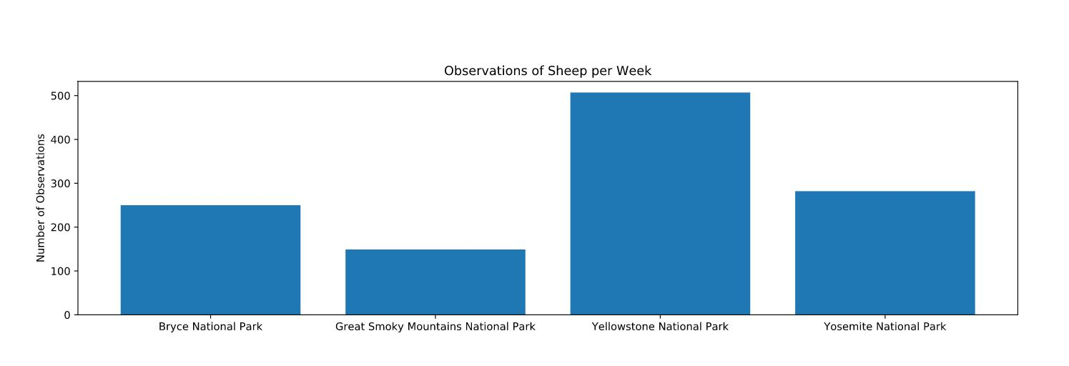
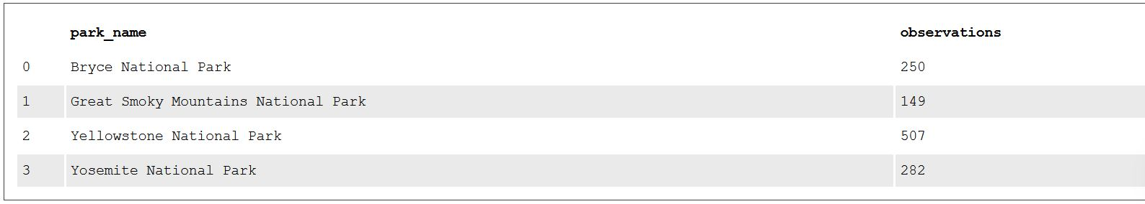
Foot and Mouth disease study
The bar chart on the left shows the observations of Sheep per week for each National Park. Based on this bar chart, the highest observation happened is in Yellowstone National Park and the lowest number is in Great Smoky Mountains National Park.
For Sample_size_per_variant, the result was 520 which means we would need 520 sheeps as a sample size to make sure the foot and mouth percentages of each park are significant.
Based on the pic below, for Yellowstone National Park, it would be one week for the scientists to spend at the National Park to observe enough sheep and for Bryce National Park, it would be two weeks.

